Slide 1
User and System Requirements
The requirements for a system are the descriptions of the services that a system should provide and the constraints on its operation.
These requirements reflect the needs of customers for a system that serves a certain purpose such as controlling a device, placing an order, or finding information.
The process of finding out, analyzing, documenting and checking these services and constraints is called requirements engineering (RE).
The term requirement is not used consistently in the software industry.
In some cases, a requirement is simply a high-level, abstract statement of a service that a system should provide or a constraint on a system.
At the other extreme, it is a detailed, formal definition of a system function. Davis (Davis 1993) explains why these differences exist:

Slide 2
User and System Requirements
If a company wishes to let a contract for a large software development project, it must define its needs in a sufficiently abstract way that a solution is not predefined.
The requirements must be written so that several contractors can bid for the contract, offering, perhaps, different ways of meeting the client organization’s needs.
Once a contract has been awarded, the contractor must write a system definition for the client in more detail so that the client understands and can validate what the software will do.
Both of these documents may be called the requirements document for the system.
Some of the problems that arise during the requirements engineering process are a result of failing to make a clear separation between these different levels of description.
They are distinguished using the term user requirements to mean the high-level abstract requirements and system requirements to mean the detailed description of what the system should do.
User requirements and system requirements may be defined as follows:

Slide 3
User and System Requirements
1. User requirements are statements, in a natural language plus diagrams, of what services the system is expected to provide to system users and the constraints under which it must operate. The user requirements may vary from broad statements of the system features required to detailed, precise descriptions of the system functionality.
2. System requirements are more detailed descriptions of the software system’s functions, services, and operational constraints. The system requirements document (sometimes called a functional specification) should define exactly what is to be implemented. It may be part of the contract between the system buyer and the software developers.
Different kinds of requirement are needed to communicate information about a system to different types of reader.
Figure below illustrates the distinction between user and system requirements.
This example from the mental health care patient information system (Mentcare) shows how a user requirement may be expanded into several system requirements. You can see from Figure below that the user requirement is quite general. The system requirements provide more specific information about the services and functions of the system that is to be implemented.

Slide 4
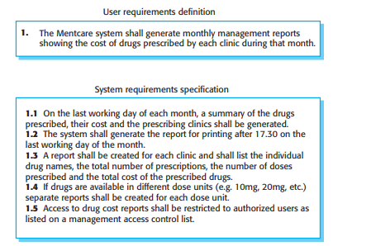
Concept of User and System Requirements
Figure: User and system requirements

Slide 5
User and System Requirements
You need to write requirements at different levels of detail because different types of readers use them in different ways.
Figure below shows the types of readers of the user and system requirements.
The readers of the user requirements are not usually concerned with how the system will be implemented and may be managers who are not interested in the detailed facilities of the system.
The readers of the system requirements need to know more precisely what the system will do because they are concerned with how it will support the business processes or because they are involved in the system implementation.
The different types of document readers shown in Figure below are examples of system stakeholders.
As well as users, many other people have some kind of interest in the system.
System stakeholders include anyone who is affected by the system in some way and so anyone who has a legitimate interest in it.
Stakeholders range from end-users of a system through managers to external stakeholders such as regulators, who certify the acceptability of the system.

Slide 6
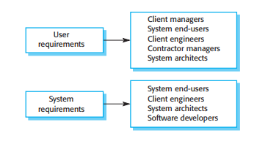
User and System Requirements
Figure: Readers of different types of requirements specification

Slide 7
User and System Requirements
For example, system stakeholders for the Mentcare system include:
1. Patients whose information is recorded in the system and relatives of these patients.
2. Doctors who are responsible for assessing and treating patients.
3. Nurses who coordinate the consultations with doctors and administer some treatments.
4. Medical receptionists who manage patients’ appointments.
5. IT staff who are responsible for installing and maintaining the system.
6. A medical ethics manager who must ensure that the system meets current ethical guidelines for patient care.
7. Health care managers who obtain management information from the system.
8. Medical records staff who are responsible for ensuring that system information can be maintained and preserved, and that record keeping procedures have been properly implemented.

Slide 8
User and System Requirements
Requirements engineering is usually presented as the first stage of the software engineering process.
However, some understanding of the system requirements may have to be developed before a decision is made to go ahead with the procurement or development of a system.
This early-stage RE establishes a high-level view of what the system might do and the benefits that it might provide.
These may then be considered in a feasibility study, which tries to assess whether or not the system is technically and financially feasible.
The results of that study help management decide whether or not to go ahead with the procurement or development of the system.
For the majority of large systems, it is still the case that there is a clearly identifiable requirements engineering phase before implementation of the system begins.
The outcome is a requirements document, which may be part of the system development contract.
Of course, subsequent changes are made to the requirements, and user requirements may be expanded into more detailed system requirements.
Sometimes an agile approach of concurrently eliciting the requirements as the system is developed may be used to add detail and to refine the user requirements.

Slide 9
functional and non-functional requirements:
Software system requirements are often classified as functional or non-functional requirements:
1. Functional requirements These are statements of services the system should provide, how the system should react to particular inputs, and how the system should behave in particular situations. In some cases, the functional requirements may also explicitly state what the system should not do.
2. Non-functional requirements These are constraints on the services or functions offered by the system. They include timing constraints, constraints on the development process, and constraints imposed by standards. Non-functional requirements often apply to the system as a whole rather than individual system features or services.
In reality, the distinction between different types of requirements is not as clear-cut as these simple definitions suggest.
A user requirement concerned with security, such as a statement limiting access to authorized users, may appear to be a nonfunctional requirement.
However, when developed in more detail, this requirement may generate other requirements that are clearly functional, such as the need to include user authentication facilities in the system.

Slide 10
functional and non-functional requirements
This shows that requirements are not independent and that one requirement often generates or constrains other requirements.
The system requirements therefore do not just specify the services or the features of the system that are required; they also specify the necessary functionality to ensure that these services/features are delivered effectively.

Slide 11
Functional requirements
The functional requirements for a system describe what the system should do.
These requirements depend on the type of software being developed, the expected users of the software, and the general approach taken by the organization when writing requirements.
When expressed as user requirements, functional requirements should be written in natural language so that system users and managers can understand them.
Functional system requirements expand the user requirements and are written for system developers.
They should describe the system functions, their inputs and outputs, and exceptions in detail.
Functional system requirements vary from general requirements covering what the system should do to very specific requirements reflecting local ways of working or an organization’s existing systems.
For example, here are examples of functional requirements for the Mentcare system, used to maintain information about patients receiving treatment for mental health problems:

Slide 12
Functional requirements
1. A user shall be able to search the appointments lists for all clinics.
2. The system shall generate each day, for each clinic, a list of patients who are expected to attend appointments that day.
3. Each staff member using the system shall be uniquely identified by his or her eight-digit employee number.
These user requirements define specific functionality that should be included in the system.
The requirements show that functional requirements may be written at different levels of detail.
Functional requirements, as the name suggests, have traditionally focused on what the system should do.
However, if an organization decides that an existing off the-shelf system software product can meet its needs, then there is very little point in developing a detailed functional specification.
In such cases, the focus should be on the development of information requirements that specify the information needed for people to do their work.

Slide 13
Functional requirements
Information requirements specify the information needed and how it is to be delivered and organized.
Therefore, an information requirement for the Mentcare system might specify what information is to be included in the list of patients expected for appointments that day.
Imprecision in the requirements specification can lead to disputes between customers and software developers.
It is natural for a system developer to interpret an ambiguous requirement in a way that simplifies its implementation.
Often, however, this is not what the customer wants.
New requirements have to be established and changes made to the system. Of course, this delays system delivery and increases costs.
For example, the first Mentcare system requirement in the above list states that a user shall be able to search the appointments lists for all clinics.
The rationale for this requirement is that patients with mental health problems are sometimes confused.
They may have an appointment at one clinic but actually go to a different clinic.
If they have an appointment, they will be recorded as having attended, regardless of the clinic.

Slide 14
Functional requirements
A medical staff member specifying a search requirement may expect “search” to mean that, given a patient name, the system looks for that name in all appointments at all clinics.
However, this is not explicit in the requirement.
System developers may interpret the requirement so that it is easier to implement.
Their search function may require the user to choose a clinic and then carry out the search of the patients who attended that clinic.
This involves more user input and so takes longer to complete the search.
Ideally, the functional requirements specification of a system should be both complete and consistent.
Completeness means that all services and information required by the user should be defined.
Consistency means that requirements should not be contradictory.

Slide 15
Functional requirements
In practice, it is only possible to achieve requirements consistency and completeness for very small software systems.
One reason is that it is easy to make mistakes and omissions when writing specifications for large, complex systems.
Another reason is that large systems have many stakeholders, with different backgrounds and expectations.
Stakeholders are likely to have different—and often inconsistent— needs.
These inconsistencies may not be obvious when the requirements are originally specified, and the inconsistent requirements may only be discovered after deeper analysis or during system development.

Slide 16
Non-functional requirements
Non-functional requirements, as the name suggests, are requirements that are not directly concerned with the specific services delivered by the system to its users.
These non-functional requirements usually specify or constrain characteristics of the system as a whole.
They may relate to emergent system properties such as reliability, response time, and memory use.
Alternatively, they may define constraints on the system implementation, such as the capabilities of I/O devices or the data representations used in interfaces with other systems.
Non-functional requirements are often more critical than individual functional requirements.
System users can usually find ways to work around a system function that doesn’t really meet their needs.
However, failing to meet a non-functional requirement can mean that the whole system is unusable.
For example, if an aircraft system does not meet its reliability requirements, it will not be certified as safe for operation; if an embedded control system fails to meet its performance requirements, the control functions will not operate correctly.

Slide 17
Non-functional requirements
While it is often possible to identify which system components implement specific functional requirements (e.g., there may be formatting components that implement reporting requirements), this is often more difficult with non-functional requirements.
The implementation of these requirements may be spread throughout the system, for two reasons:
1. Non-functional requirements may affect the overall architecture of a system rather than the individual components. For example, to ensure that performance requirements are met in an embedded system, you may have to organize the system to minimize communications between components.
2. An individual non-functional requirement, such as a security requirement, may generate several, related functional requirements that define new system services that are required if the non-functional requirement is to be implemented. In addition, it may also generate requirements that constrain existing requirements; for example, it may limit access to information in the system.

Slide 18
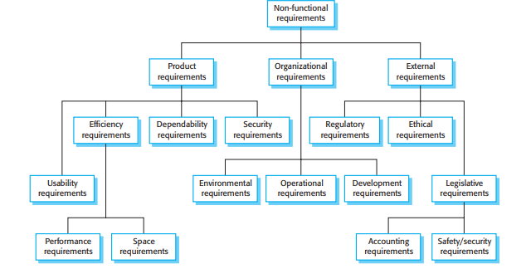
Non-functional requirements
Figure: Types of non-functional requirements

Slide 19
Non-functional requirements
Nonfunctional requirements arise through user needs because of budget constraints, organizational policies, the need for interoperability with other software or hardware systems, or external factors such as safety regulations or privacy legislation. Figure above is a classification of non-functional requirements.
You can see from this diagram that the non-functional requirements may come from required characteristics of the software (product requirements), the organization developing the software (organizational requirements), or external sources:
1. Product requirements These requirements specify or constrain the runtime behavior of the software. Examples include performance requirements for how fast the system must execute and how much memory it requires; reliability requirements that set out the acceptable failure rate; security requirements; and usability requirements.
2. Organizational requirements These requirements are broad system requirements derived from policies and procedures in the customer’s and developer’s organizations. Examples include operational process requirements that define how the system will be used; development process requirements that specify the programming language; the development environment or process standards to be used; and environmental requirements that specify the operating environment of the system.

Slide 20
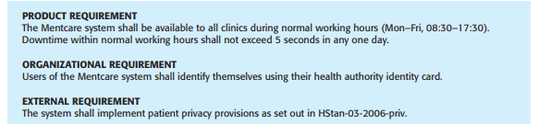
Non-functional requirements
3. External requirements This broad heading covers all requirements that are derived from factors external to the system and its development process. These may include regulatory requirements that set out what must be done for the system to be approved for use by a regulator, such as a nuclear safety authority; legislative requirements that must be followed to ensure that the system operates within the law; and ethical requirements that ensure that the system will be acceptable to its users and the general public.
Figure: Examples of possible non-functional requirements for the Mentcare system

Slide 21
Non-functional requirements
Figure above shows examples of product, organizational, and external requirements that could be included in the Mentcare system specification.
The product requirement is an availability requirement that defines when the system has to be available and the allowed downtime each day.
It says nothing about the functionality of the Mentcare system and clearly identifies a constraint that has to be considered by the system designers.
The organizational requirement specifies how users authenticate themselves to the system.
The health authority that operates the system is moving to a standard authentication procedure for all software where, instead of users having a login name, they swipe their identity card through a reader to identify themselves.
The external requirement is derived from the need for the system to conform to privacy legislation. Privacy is obviously a very important issue in health care systems, and the requirement specifies that the system should be developed in accordance with a national privacy standard.

Slide 22
Non-functional requirements
A common problem with non-functional requirements is that stakeholders propose requirements as general goals, such as ease of use, the ability of the system to recover from failure, or rapid user response.
Goals set out good intentions but cause problems for system developers as they leave scope for interpretation and subsequent dispute once the system is delivered.
For example, the following system goal is typical of how a manager might express usability requirements:
The system should be easy to use by medical staff and should be organized in such a way that user errors are minimized.

Slide 23
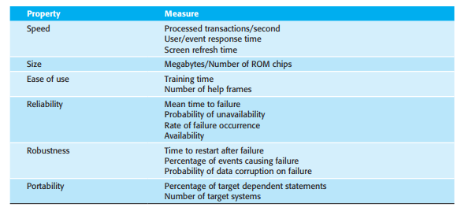
Non-functional requirements
Fig: Metrics for specifying nonfunctional requirements

Slide 24
Non-functional requirements
It is impossible to objectively verify the system goal, but in the following description you can at least include software instrumentation to count the errors made by users when they are testing the system.
Medical staff shall be able to use all the system functions after two hours of training. After this training, the average number of errors made by experienced users shall not exceed two per hour of system use.
Whenever possible, you should write non-functional requirements quantitatively so that they can be objectively tested.
Figure above shows metrics that you can use to specify non-functional system properties.
You can measure these characteristics when the system is being tested to check whether or not the system has met its nonfunctional requirements.
In practice, customers for a system often find it difficult to translate their goals into measurable requirements. For some goals, such as maintainability, there are no simple metrics that can be used.
In other cases, even when quantitative specification is possible, customers may not be able to relate their needs to these specifications.

Slide 25
Non-functional requirements
They don’t understand what some number defining the reliability (for example) means in terms of their everyday experience with computer systems.
Furthermore, the cost of objectively verifying measurable, non-functional requirements can be very high, and the customers paying for the system may not think these costs are justified.
Non-functional requirements often conflict and interact with other functional or non-functional requirements.
For example, the identification requirement requires a card reader to be installed with each computer that connects to the system.
However, there may be another requirement that requests mobile access to the system from doctors’ or nurses’ tablets or smartphones.
These are not normally equipped with card readers so, in these circumstances, some alternative identification method may have to be supported.

Slide 26
Non-functional requirements
It is difficult to separate functional and non-functional requirements in the requirements document.
If the non-functional requirements are stated separately from the functional requirements, the relationships between them may be hard to understand.
However, you should, ideally, highlight requirements that are clearly related to emergent system properties, such as performance or reliability.
You can do this by putting them in a separate section of the requirements document or by distinguishing them, in some way, from other system requirements.
Non-functional requirements such as reliability, safety, and confidentiality requirements are particularly important for critical systems.

Slide 27
Requirements engineering
Requirements engineering involves three key activities.
These are discovering requirements by interacting with stakeholders (elicitation and analysis); converting these requirements into a standard form (specification); and checking that the requirements actually define the system that the customer wants (validation).
In practice, requirements engineering is an iterative process in which the activities are interleaved.
Figure below shows this interleaving.
The activities are organized as an iterative process around a spiral.
The output of the RE process is a system requirements document.
The amount of time and effort devoted to each activity in an iteration depends on the stage of the overall process, the type of system being developed, and the budget that is available.
Early in the process, most effort will be spent on understanding high-level business and non-functional requirements, and the user requirements for the system.
Later in the process, in the outer rings of the spiral, more effort will be devoted to eliciting and understanding the non-functional requirements and more detailed system requirements.

Slide 28
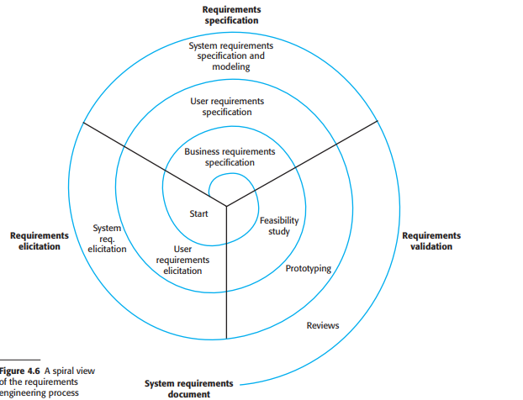
Requirements engineering

Slide 29
Requirements engineering
This spiral model accommodates approaches to development where the requirements are developed to different levels of detail.
The number of iterations around the spiral can vary so that the spiral can be exited after some or all of the user requirements have been elicited.
Agile development can be used instead of prototyping so that the requirements and the system implementation are developed together.
In virtually all systems, requirements change. The people involved develop a better understanding of what they want the software to do; the organization buying the system changes; and modifications are made to the system’s hardware, software, and organizational environment.
Changes have to be managed to understand the impact on other requirements and the cost and system implications of making the change.

Slide 30
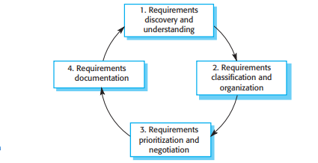
Requirements Elicitation
The aims of the requirements elicitation process are to understand the work that stakeholders do and how they might use a new system to help support that work.
During requirements elicitation, software engineers work with stakeholders to find out about the application domain, work activities, the services and system features that stakeholders want, the required performance of the system, hardware constraints, and so on.
Eliciting and understanding requirements from system stakeholders is a difficult process for several reasons:
1. Stakeholders often don’t know what they want from a computer system except in the most general terms; they may find it difficult to articulate what they want the system to do; they may make unrealistic demands because they don’t know what is and isn’t feasible.
Figure: The requirements elicitation and analysis process

Slide 31
Requirements Elicitation
2. Stakeholders in a system naturally express requirements in their own terms and with implicit knowledge of their own work. Requirements engineers, without experience in the customer’s domain, may not understand these requirements.
3. Different stakeholders, with diverse requirements, may express their requirements in different ways. Requirements engineers have to discover all potential sources of requirements and discover commonalities and conflict.
4. Political factors may influence the requirements of a system. Managers may demand specific system requirements because these will allow them to increase their influence in the organization.
5. The economic and business environment in which the analysis takes place is dynamic. It inevitably changes during the analysis process. The importance of particular requirements may change. New requirements may emerge from new stakeholders who were not originally consulted.
A process model of the elicitation and analysis process is shown in Figure above.
Each organization will have its own version or instantiation of this general model, depending on local factors such as the expertise of the staff, the type of system being developed, and the standards used.

Slide 32
Requirements Elicitation
The process activities are:
1. Requirements discovery and understanding This is the process of interacting with stakeholders of the system to discover their requirements. Domain requirements from stakeholders and documentation are also discovered during this activity.
2. Requirements classification and organization This activity takes the unstructured collection of requirements, groups related requirements and organizes them into coherent clusters.
3. Requirements prioritization and negotiation Inevitably, when multiple stakeholders are involved, requirements will conflict. This activity is concerned with prioritizing requirements and finding and resolving requirements conflicts through negotiation. Usually, stakeholders have to meet to resolve differences and agree on compromise requirements.
4. Requirements documentation The requirements are documented and input into the next round of the spiral. An early draft of the software requirements documents may be produced at this stage, or the requirements may simply be maintained informally on whiteboards, wikis, or other shared spaces.

Slide 33
Requirements Elicitation
Figure above shows that requirements elicitation and analysis is an iterative process with continual feedback from each activity to other activities.
The process cycle starts with requirements discovery and ends with the requirements documentation.
The analyst’s understanding of the requirements improves with each round of the cycle. The cycle ends when the requirements document has been produced.
To simplify the analysis of requirements, it is helpful to organize and group the stakeholder information.
One way of doing so is to consider each stakeholder group to be a viewpoint and to collect all requirements from that group into the viewpoint.
You may also include viewpoints to represent domain requirements and constraints from other systems.
Alternatively, you can use a model of the system architecture to identify subsystems and to associate requirements with each subsystem.

Slide 34
Requirements Elicitation
Inevitably, different stakeholders have different views on the importance and priority of requirements, and sometimes these views are conflicting.
If some stakeholders feel that their views have not been properly considered, then they may deliberately attempt to undermine the RE process.
Therefore, it is important that you organize regular stakeholder meetings. Stakeholders should have the opportunity to express their concerns and agree on requirements compromises.
At the requirements documentation stage, it is important that you use simple language and diagrams to describe the requirements.
This makes it possible for stakeholders to understand and comment on these requirements. To make information sharing easier, it is best to use a shared document (e.g., on Google Docs or Office 365) or a wiki that is accessible to all interested stakeholders.

Slide 35
Requirements elicitation techniques
Requirements elicitation involves meeting with stakeholders of different kinds to discover information about the proposed system.
You may supplement this information with knowledge of existing systems and their usage and information from documents of various kinds.
You need to spend time understanding how people work, what they produce, how they use other systems, and how they may need to change to accommodate a new system.
There are two fundamental approaches to requirements elicitation:
1. Interviewing, where you talk to people about what they do.
2. Observation or ethnography, where you watch people doing their job to see what artifacts they use, how they use them, and so on.
You should use a mix of interviewing and observation to collect information and, from that, you derive the requirements, which are then the basis for further discussions.

Slide 36
Interviewing
Formal or informal interviews with system stakeholders are part of most requirements engineering processes. In these interviews, the requirements engineering team puts questions to stakeholders about the system that they currently use and the system to be developed.
Requirements are derived from the answers to these questions.
Interviews may be of two types:
1. Closed interviews, where the stakeholder answers a predefined set of questions.
2. Open interviews, in which there is no predefined agenda. The requirements engineering team explores a range of issues with system stakeholders and hence develops a better understanding of their needs.
In practice, interviews with stakeholders are normally a mixture of both of these.
You may have to obtain the answer to certain questions, but these usually lead to other issues that are discussed in a less structured way.
Completely open-ended discussions rarely work well. You usually have to ask some questions to get started and to keep the interview focused on the system to be developed.

Slide 37
Interviewing
Interviews are good for getting an overall understanding of what stakeholders do, how they might interact with the new system, and the difficulties that they face with current systems.
People like talking about their work, and so they are usually happy to get involved in interviews. However, unless you have a system prototype to demonstrate, you should not expect stakeholders to suggest specific and detailed requirements.
Everyone finds it difficult to visualize what a system might be like.
You need to analyze the information collected and to generate the requirements from this.
Eliciting domain knowledge through interviews can be difficult, for two reasons:
1. All application specialists use jargon specific to their area of work. It is impossible for them to discuss domain requirements without using this terminology. They normally use words in a precise and subtle way that requirements engineers may misunderstand.
2. Some domain knowledge is so familiar to stakeholders that they either find it difficult to explain or they think it is so fundamental that it isn’t worth mentioning. For example, for a librarian, it goes without saying that all acquisitions are catalogued before they are added to the library. However, this may not be obvious to the interviewer, and so it isn’t taken into account in the requirements.

Slide 38
Interviewing
Interviews are not an effective technique for eliciting knowledge about organizational requirements and constraints because there are subtle power relationships between the different people in the organization.
Published organizational structures rarely match the reality of decision making in an organization, but interviewees may not wish to reveal the actual rather than the theoretical structure to a stranger.
In general, most people are generally reluctant to discuss political and organizational issues that may affect the requirements.
To be an effective interviewer, you should bear two things in mind:
1. You should be open-minded, avoid preconceived ideas about the requirements, and willing to listen to stakeholders. If the stakeholder comes up with surprising requirements, then you should be willing to change your mind about the system.
2. You should prompt the interviewee to get discussions going by using a springboard question or a requirements proposal, or by working together on a prototype system. Saying to people “tell me what you want” is unlikely to result in useful information. They find it much easier to talk in a defined context rather than in general terms.

Slide 39
Interviewing
Information from interviews is used along with other information about the system from documentation describing business processes or existing systems, user observations, and developer experience.
Sometimes, apart from the information in the system documents, the interview information may be the only source of information about the system requirements. However, interviewing on its own is liable to miss essential information, and so it should be used in conjunction with other requirements elicitation techniques.

Slide 40
Ethnography
Software systems do not exist in isolation. They are used in a social and organizational environment, and software system requirements may be generated or constrained by that environment.
One reason why many software systems are delivered but never used is that their requirements do not take proper account of how social and organizational factors affect the practical operation of the system.
It is therefore very important that, during the requirements engineering process, you try to understand the social and organizational issues that affect the use of the system.
Ethnography is an observational technique that can be used to understand operational processes and help derive requirements for software to support these processes.
An analyst immerses himself or herself in the working environment where the system will be used. The day-to-day work is observed, and notes are made of the actual tasks in which participants are involved.
The value of ethnography is that it helps discover implicit system requirements that reflect the actual ways that people work, rather than the formal processes defined by the organization.

Slide 41
Ethnography
People often find it very difficult to articulate details of their work because it is second nature to them.
They understand their own work but may not understand its relationship to other work in the organization.
Social and organizational factors that affect the work, but that are not obvious to individuals, may only become clear when noticed by an unbiased observer.
For example, a workgroup may self-organize so that members know of each other’s work and can cover for each other if someone is absent.
This may not be mentioned during an interview as the group might not see it as an integral part of their work.
Suchman pioneered the use of ethnography to study office work. She found that actual work practices were far richer, more complex, and more dynamic than the simple models assumed by office automation systems.
The difference between the assumed and the actual work was the most important reason why these office systems had no significant effect on productivity. Crabtree discusses a wide range of studies since then and describes, in general, the use of ethnography in systems design. In my own research, I have investigated methods of integrating ethnography into the software engineering process by linking it with requirements engineering methods and documenting patterns of interaction in cooperative systems.

Slide 42
Ethnography
Ethnography is particularly effective for discovering two types of requirements:
1. Requirements derived from the way in which people actually work, rather than the way in which business process definitions say they ought to work. In practice, people never follow formal processes. For example, air traffic controllers may switch off a conflict alert system that detects aircraft with intersecting flight paths, even though normal control procedures specify that it should be used. The conflict alert system is sensitive and issues audible warnings even when planes are far apart. Controllers may find these distracting and prefer to use other strategies to ensure that planes are not on conflicting flight paths.
2. Requirements derived from cooperation and awareness of other people’s activities. For example, air traffic controllers (ATCs) may use an awareness of other controlles’ work to predict the number of aircraft that will be entering their control sector. They then modify their control strategies depending on that predicted workload. Therefore, an automated ATC system should allow controllers in a sector to have some visibility of the work in adjacent sectors.
Ethnography can be combined with the development of a system prototype (Figure 4.8). The ethnography informs the development of the prototype so that fewer prototype refinement cycles are required.
Furthermore, the prototyping focuses the ethnography by identifying problems and questions that can then be discussed with the ethnographer. He or she should then look for the answers to these questions during the next phase of the system study.

Slide 43
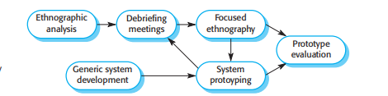
Ethnography
Ethnography is helpful to understand existing systems, but this understanding does not always help with innovation. Innovation is particularly relevant for new product development.
Commentators have suggested that Nokia used ethnography to discover how people used their phones and developed new phone models on that basis; Apple, on the other hand, ignored current use and revolutionized the mobile phone industry with the introduction of the iPhone.
Ethnographic studies can reveal critical process details that are often missed by other requirements elicitation techniques.
However, because of its focus on the end-user, this approach is not effective for discovering broader organizational or domain requirements or for suggestion innovations. You therefore have to use ethnography as one of a number of techniques for requirements elicitation.
Fig: Ethnography and prototyping for requirements analysis.

Slide 44
Stories and scenarios
People find it easier to relate to real-life examples than abstract descriptions.
They are not good at telling you the system requirements. However, they may be able to describe how they handle particular situations or imagine things that they might do in a new way of working. Stories and scenarios are ways of capturing this kind of information.
You can then use these when interviewing groups of stakeholders to discuss the system with other stakeholders and to develop more specific system requirements.
Stories and scenarios are essentially the same thing. They are a description of how the system can be used for some particular task. They describe what people do, what information they use and produce, and what systems they may use in this process.
The difference is in the ways that descriptions are structured and in the level of detail presented.
Stories are written as narrative text and present a high-level description of system use; scenarios are usually structured with specific information collected such as inputs and outputs.
I find stories to be effective in setting out the “big picture.” Parts of stories can then be developed in more detail and represented as scenarios.

Slide 45
Stories and scenarios
Figure below is an example of a story that I developed to understand the requirements for the iLearn digital learning environment.
This story describes a situation in a primary (elementary) school where the teacher is using the environment to support student projects on the fishing industry.
You can see this is a very high-level description. Its purpose is to facilitate discussion of how the iLearn system might be used and to act as a starting point for eliciting the requirements for that system.
The advantage of stories is that everyone can easily relate to them. We found this approach to be particularly useful to get information from a wider community than
we could realistically interview. We made the stories available on a wiki and invited teachers and students from across the country to comment on them.
These high-level stories do not go into detail about a system, but they can be developed into more specific scenarios. Scenarios are descriptions of example user
interaction sessions. I think that it is best to present scenarios in a structured way rather than as narrative text. User stories used in agile methods such as Extreme Programming, are actually narrative scenarios rather than general stories to help elicit requirements.
A scenario starts with an outline of the interaction. During the elicitation process, details are added to create a complete description of that interaction. At its most general, a scenario may include:

Slide 46
Stories and scenarios
Photo sharing in the classroom
Jack is a primary school teacher in Ullapool (a village in northern Scotland). He has decided that a class project should be focused on the fishing industry in the area, looking at the history, development, and economic impact of fishing. As part of this project, pupils are asked to gather and share reminiscences from relatives, use newspaper archives, and collect old photographs related to fishing and fishing communities in the area. Pupils use an iLearn wiki to gather together fishing stories and SCRAN (a history resources site) to access newspaper archives and photographs. However, Jack also needs a photo-sharing site because he wants pupils to take and comment on each other’s photos and to upload scans of old photographs that they may have in their families. Jack sends an email to a primary school teachers’ group, which he is a member of, to see if anyone can recommend an appropriate system. Two teachers reply, and both suggest that he use KidsTakePics, a photo-sharing site that allows teachers to check and moderate content. As KidsTakePics is not integrated with the iLearn authentication service, he sets up a teacher and a class account. He uses the iLearn setup service to add KidsTakePics to the services seen by the pupils in his class so that when they log in, they can immediately use the system to upload photos from their mobile devices and class computers.

Slide 47
Stories and scenarios
1. A description of what the system and users expect when the scenario starts.
2. A description of the normal flow of events in the scenario.
3. A description of what can go wrong and how resulting problems can be handled.
4. Information about other activities that might be going on at the same time.
5. A description of the system state when the scenario ends.
As an example of a scenario, Figure below describes what happens when a student uploads photos to the KidsTakePics system, as explained in Figure above. The key difference between this system and other systems is that a teacher moderates the uploaded photos to check that they are suitable for sharing.
You can see this is a much more detailed description than the story in Figure above, and so it can be used to propose requirements for the iLearn system.
Like stories, scenarios can be used to facilitate discussions with stakeholders who sometimes may have different ways of achieving the same result.

Slide 48
Stories and scenarios
Uploading photos to KidsTakePics
Initial assumption: A user or a group of users have one or more digital photographs to be uploaded to the picture-sharing site. These photos are saved on either a tablet or a laptop computer. They have successfully
logged on to KidsTakePics. Normal: The user chooses to upload photos and is prompted to select the photos to be uploaded on the computer and to select the project name under which the photos will be stored. Users should also be given the option of inputting keywords that should be associated with each uploaded photo. Uploaded photos are named by creating a conjunction of the user name with the filename of the photo on the local computer. On completion of the upload, the system automatically sends an email to the project moderator, asking them to check new content, and generates an on-screen message to the user that this checking has been done. What can go wrong: No moderator is associated with the selected project. An email is automatically generated to the school administrator asking them to nominate a project moderator. Users should be informed of a possible delay in making their photos visible. Photos with the same name have already been uploaded by the same user. The user should be asked if he or she wishes to re-upload the photos with the same name, rename the photos, or cancel the upload. If users choose to re-upload the photos, the originals are overwritten. If they choose to rename the photos, a new name is automatically generated by adding a number to the existing filename. Other activities: The moderator may be logged on to the system and may approve photos as they are uploaded. System state on completion: User is logged on. The selected photos have been uploaded and assigned a status “awaiting moderation.” Photos are visible to the moderator and to the user who uploaded them.

Slide 49
Requirements specification
Requirements specification is the process of writing down the user and system requirements in a requirements document. Ideally, the user and system requirements should be clear, unambiguous, easy to understand, complete, and consistent.
In practice, this is almost impossible to achieve. Stakeholders interpret the requirements in different ways, and there are often inherent conflicts and inconsistencies in the requirements.
User requirements are almost always written in natural language supplemented by appropriate diagrams and tables in the requirements document.
System requirements may also be written in natural language, but other notations based on forms, graphical, or mathematical system models can also be used.
Figure below summarizes possible notations for writing system requirements.
The user requirements for a system should describe the functional and nonfunctional
requirements so that they are understandable by system users who don’t have detailed
technical knowledge. Ideally, they should specify only the external behavior of the system. The requirements document should not include details of the system architecture or design.
Consequently, if you are writing user requirements, you should not use software jargon, structured notations, or formal notations. You should write user requirements in natural language, with simple tables, forms, and intuitive diagrams.

Slide 50
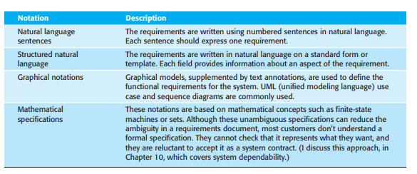
Requirements specification
Fig: Notations for writing system requirements

Slide 51
Requirements specification
System requirements are expanded versions of the user requirements that software engineers use as the starting point for the system design.
They add detail and explain how the system should provide the user requirements. They may be used as part of the contract for the implementation of the system and should therefore be a complete and detailed specification of the whole system.
Ideally, the system requirements should only describe the external behavior of the system and its operational constraints.
They should not be concerned with how the system should be designed or implemented. However, at the level of detail required to completely specify a complex software system, it is neither possible nor desirable to exclude all design information.
There are several reasons for this:
1. You may have to design an initial architecture of the system to help structure the requirements specification. The system requirements are organized according to the different subsystems that make up the system.

Slide 52
Requirements specification
2. In most cases, systems must interoperate with existing systems, which constrain the design and impose requirements on the new system.
3. The use of a specific architecture to satisfy non-functional requirements, such as N-version programming to achieve reliability. An external regulator who needs to certify that the system is safe may specify that an architectural design that has already been certified should be used.

Slide 53
Natural language specification
Natural language has been used to write requirements for software since the 1950s.
It is expressive, intuitive, and universal. It is also potentially vague and ambiguous, and its interpretation depends on the background of the reader. As a result, there have been many proposals for alternative ways to write requirements.
However, none of these proposals has been widely adopted, and natural language will continue
to be the most widely used way of specifying system and software requirements.
To minimize misunderstandings when writing natural language requirements, it is recommended that you follow these simple guidelines:
1. Invent a standard format and ensure that all requirement definitions adhere to that format. Standardizing the format makes omissions less likely and requirements easier to check. I suggest that, wherever possible, you should write the requirement in one or two sentences of natural language.
2. Use language consistently to distinguish between mandatory and desirable requirements. Mandatory requirements are requirements that the system must support and are usually written using “shall.” Desirable requirements are not essential and are written using “should.”
3. Use text highlighting (bold, italic, or color) to pick out key parts of the requirement.
4. Do not assume that readers understand technical, software engineering language. It is easy for words such as “architecture” and “module” to be misunderstood. Wherever possible, you should avoid the use of jargon, abbreviations, and acronyms.
5. Whenever possible, you should try to associate a rationale with each user requirement. The rationale should explain why the requirement has been included and who proposed the requirement (the requirement source), so that you know whom to consult if the requirement has to be changed. Requirements rationale is particularly useful when requirements are changed, as it may help decide what changes would be undesirable.

Slide 54
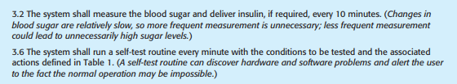
Natural language specification
Figure below illustrates how these guidelines may be used.
It includes two requirements for the embedded software for the automated insulin pump, introduced in Chapter 1. Other requirements for this embedded system are defined in the insulin pump requirements document, which can be downloaded from the book’s web pages.
Figure: Example requirements for the insulin pump software system

Slide 55
Structured specifications
Structured natural language is a way of writing system requirements where requirements are written in a standard way rather than as free-form text. This approach maintains most of the expressiveness and understandability of natural language but ensures that some uniformity is imposed on the specification.
Structured language notations use templates to specify system requirements. The specification may use programming language constructs to show alternatives and iteration, and may highlight key elements using shading or different fonts.
The Robertson, in their book on the VOLERE requirements engineering method, recommend that user requirements be initially written on cards, one requirement per card. They suggest a number of fields on each card, such as the requirements rationale, the dependencies on other requirements, the source of the requirements, and supporting materials. This is similar to the approach used in the example of a structured specification shown in Figure below.
To use a structured approach to specifying system requirements, you define one or more standard templates for requirements and represent these templates as structured forms. The specification may be structured around the objects manipulated by the system, the functions performed by the system, or the events processed by the system.
An example of a form-based specification, in this case, one that defines how to calculate the dose of insulin to be delivered when the blood sugar is within a safe band, is shown in Figure below.

Slide 56
Structured specifications
When a standard format is used for specifying functional requirements, the following information should be included:
1. A description of the function or entity being specified.
2. A description of its inputs and the origin of these inputs.
3. A description of its outputs and the destination of these outputs.
4. Information about the information needed for the computation or other entities in the system that are required (the “requires” part).
5. A description of the action to be taken.
6. If a functional approach is used, a precondition setting out what must be true before the function is called, and a postcondition specifying what is true after the function is called.
7. A description of the side effects (if any) of the operation.
Using structured specifications removes some of the problems of natural language specification. Variability in the specification is reduced, and requirements are organized more effectively. However, it is still sometimes difficult to write requirements in a clear and unambiguous way, particularly when complex computations (e.g., how to calculate the insulin dose) are to be specified.

Slide 57
Structured specifications
To address this problem, you can add extra information to natural language requirements, for example, by using tables or graphical models of the system.
These can show how computations proceed, how the system state changes, how users interact with the system, and how sequences of actions are performed.
Tables are particularly useful when there are a number of possible alternative situations and you need to describe the actions to be taken for each of these. The insulin pump bases its computations of the insulin requirement on the rate of change of blood sugar levels. The rates of change are computed using the current and previous readings.
Figure below is a tabular description of how the rate of change of blood sugar is used to calculate the amount of insulin to be delivered.

Slide 58
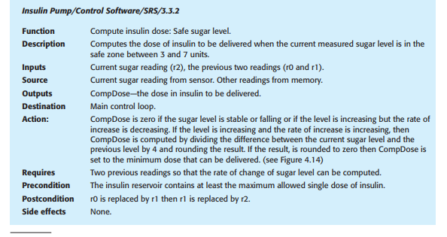
Structured specifications
Figure: The structured specification of a requirement for an insulin pump

Slide 59
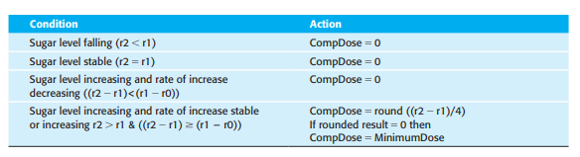
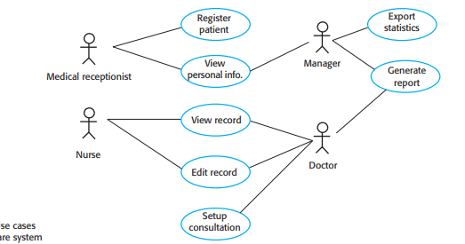
Structured specifications
Figure: The tabular specification of computation in an insulin pump
Figure 4.15 Use cases consultation for the Mentcare system

Slide 60
Use cases
Use cases are a way of describing interactions between users and a system using a graphical model and structured text.
They were first introduced in the Objectory method (Jacobsen et al. 1993) and have now become a fundamental feature of the Unified Modeling Language (UML). In their simplest form, a use case identifies the actors involved in an interaction and names the type of interaction.
You then add additional information describing the interaction with the system. The additional information may be a textual description or one or more graphical models such as the UML sequence or state charts.
Use cases are documented using a high-level use case diagram. The set of use cases represents all of the possible interactions that will be described in the system requirements.
Actors in the process, who may be human or other systems, are represented as stick figures. Each class of interaction is represented as a named ellipse.
Lines link the actors with the interaction. Optionally, arrowheads may be added to lines to show how the interaction is initiated. This is illustrated in Figure above, which shows some of the use cases for the Mentcare system.

Slide 61
Use cases
Use cases identify the individual interactions between the system and its users or other systems. Each use case should be documented with a textual description.
These can then be linked to other models in the UML that will develop the scenario in more detail. For example, a brief description of the Setup Consultation use case from Figure above might be:
Setup consultation allows two or more doctors, working in different offices, to view the same patient record at the same time. One doctor initiates the consultation by choosing the people involved from a dropdown menu of doctors who are online. The patient record is then displayed on their screens, but only the initiating doctor can edit the record. In addition, a text chat window is created to help coordinate actions. It is assumed that a phone call for voice communication can be separately arranged.
The UML is a standard for object-oriented modeling, so use cases and use casebased elicitation are used in the requirements engineering process. However, my experience with use cases is that they are too fine-grained to be useful in discussing requirements. Stakeholders don’t understand the term use case; they don’t find them graphical model to be useful, and they are often not interested in a detailed description of each and every system interaction. Consequently, I find use cases to be more helpful in systems design than in requirements engineering.

Slide 62
The software requirements document
The software requirements document (sometimes called the software requirements specification or SRS) is an official statement of what the system developers should implement.
It may include both the user requirements for a system and a detailed specification of the system requirements. Sometimes the user and system requirements are integrated into a single description. In other cases, the user requirements are described in an introductory chapter in the system requirements specification.
Requirements documents are essential when systems are outsourced for development, when different teams develop different parts of the system, and when a detailed analysis of the requirements is mandatory. In other circumstances, such as software product or business system development, a detailed requirements document may not be needed.
Agile methods argue that requirements change so rapidly that a requirements document is out of date as soon as it is written, so the effort is largely wasted.
Rather than a formal document, agile approaches often collect user requirements incrementally and write these on cards or whiteboards as short user stories. The user then prioritizes these stories for implementation in the next increment of the system.

Slide 63
The software requirements document
For business systems where requirements are unstable, I think that this approach is a good one.
However, I think that it is still useful to write a short supporting document that defines the business and dependability requirements for the system; it is easy to forget the requirements that apply to the system as a whole when focusing on the functional requirements for the next system release.
The requirements document has a diverse set of users, ranging from the senior management of the organization that is paying for the system to the engineers responsible for developing the software. Figure below shows possible users of the document and how they use it.
The diversity of possible users means that the requirements document has to be a compromise.
It has to describe the requirements for customers, define the requirements in precise detail for developers and testers, as well as include information about future system evolution.
Information on anticipated changes helps system designers to avoid restrictive design decisions and maintenance engineers to adapt the system to new requirements.

Slide 64
The software requirements document
The level of detail that you should include in a requirements document depends on the type of system that is being developed and the development process used.
Critical systems need detailed requirements because safety and security have to be analyzed in detail to find possible requirements errors.
When the system is to be developed by a separate company (e.g., through outsourcing), the system specifications need to be detailed and precise.
If an in-house, iterative development process is used, the requirements document can be less detailed. Details can be added to the requirements and ambiguities resolved during development of the system.
Figure below shows one possible organization for a requirements document that is based on an IEEE standard for requirements documents (IEEE 1998). This standard is a generic one that can be adapted to specific uses.
In this case, the standard has been extended to include information about predicted system evolution. This information helps the maintainers of the system and allows designers to include support for future system features.

Slide 65
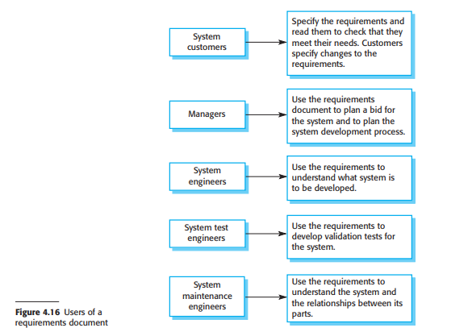
The software requirements document

Slide 66
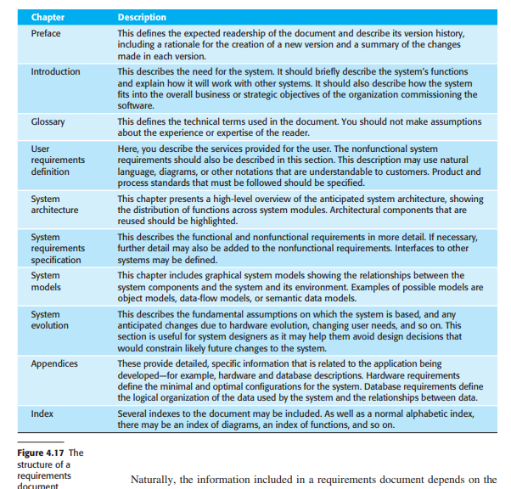
The software requirements document

Slide 67
The software requirements document
Naturally, the information included in a requirements document depends on the type of software being developed and the approach to development that is to be used.
A requirements document with a structure like that shown in Figure above might be produced for a complex engineering system that includes hardware and software developed by different companies.
The requirements document is likely to be long and detailed.
It is therefore important that a comprehensive table of contents and document index be included so that readers can easily find the information they need.
By contrast, the requirements document for an in-house software product will leave out many of detailed chapters suggested above.
The focus will be on defining the user requirements and high-level, nonfunctional system requirements. The system designers and programmers use their judgment to decide how to meet the outline user requirements for the system.

Slide 68
Requirements validation
Requirements validation is the process of checking that requirements define the system that the customer really wants.
It overlaps with elicitation and analysis, as it is concerned with finding problems with the requirements.
Requirements validation is critically important because errors in a requirements document can lead to extensive rework costs when these problems are discovered during development or after the system is in service.
The cost of fixing a requirements problem by making a system change is usually much greater than repairing design or coding errors. A change to the requirements usually means that the system design and implementation must also be changed.
Furthermore, the system must then be retested. During the requirements validation process, different types of checks should be carried out on the requirements in the requirements document. These checks include:

Slide 69
Requirements validation
1. Validity checks These check that the requirements reflect the real needs of system users. Because of changing circumstances, the user requirements may have changed since they were originally elicited.
2. Consistency checks Requirements in the document should not conflict. That is, there should not be contradictory constraints or different descriptions of the same system function.
3. Completeness checks The requirements document should include requirements that define all functions and the constraints intended by the system user.
4. Realism checks By using knowledge of existing technologies, the requirements should be checked to ensure that they can be implemented within the proposed budget for the system. These checks should also take account of the budget and schedule for the system development.
5. Verifiability To reduce the potential for dispute between customer and contractor, system requirements should always be written so that they are verifiable. This means that you should be able to write a set of tests that can demonstrate that the delivered system meets each specified requirement.

Slide 70
Requirements validation
A number of requirements validation techniques can be used individually or in conjunction with one another:
1. Requirements reviews The requirements are analyzed systematically by a team of reviewers who check for errors and inconsistencies.
2. Prototyping This involves developing an executable model of a system and using this with end-users and customers to see if it meets their needs and expectations. Stakeholders experiment with the system and feed back requirements changes to the development team.
3. Test-case generation Requirements should be testable. If the tests for the requirements are devised as part of the validation process, this often reveals requirements problems. If a test is difficult or impossible to design, this usually means that the requirements will be difficult to implement and should be reconsidered. Developing tests from the user requirements before any code is written is an integral part of test-driven development.
You should not underestimate the problems involved in requirements validation. Ultimately, it is difficult to show that a set of requirements does in fact meet a user’s needs. Users need to picture the system in operation and imagine how that system would fit into their work. It is hard even for skilled computer professionals to perform this type of abstract analysis and harder still for system users.
As a result, you rarely find all requirements problems during the requirements validation process. Inevitably, further requirements changes will be needed to correct omissions and misunderstandings after agreement has been reached on the requirements document.

Slide 71
Requirement Change
The requirements for large software systems are always changing.
One reason for the frequent changes is that these systems are often developed to address “wicked” problems—problems that cannot be completely defined.
Because the problem cannot be fully defined, the software requirements are bound to be incomplete.
During the software development process, the stakeholders’ understanding of the problem is constantly changing (Figure below).
The system requirements must then evolve to reflect this changed problem understanding.
Once a system has been installed and is regularly used, new requirements inevitably emerge.
This is partly a consequence of errors and omissions in the original requirements that have to be corrected.
However, most changes to system requirements arise because of changes to the business environment of the system:

Slide 72
Requirement Change
1. The business and technical environment of the system always changes after installation. New hardware may be introduced and existing hardware updated. It may be necessary to interface the system with other systems. Business priorities may change (with consequent changes in the system support required), and new legislation and regulations may be introduced that require system compliance.
2. The people who pay for a system and the users of that system are rarely the same people. System customers impose requirements because of organizational and budgetary constraints. These may conflict with end-user requirements, and, after delivery, new features may have to be added for user support if the system is to meet its goals.
3. Large systems usually have a diverse stakeholder community, with stakeholders having different requirements. Their priorities may be conflicting or contradictory. The final system requirements are inevitably a compromise, and some stakeholders have to be given priority. With experience, it is often discovered that the balance of support given to different stakeholders has to be changed and the requirements re-prioritized.

Slide 73
Requirement Change
As requirements are evolving, you need to keep track of individual requirements and maintain links between dependent requirements so that you can assess the impact of requirements changes.
You therefore need a formal process for making change proposals and linking these to system requirements.
This process of “requirements management” should start as soon as a draft version of the requirements document is available.
Agile development processes have been designed to cope with requirements that change during the development process. In these processes, when a user proposes a requirements change, this change does not go through a formal change management process.
Rather, the user has to prioritize that change and, if it is high priority, decide what system features that were planned for the next iteration should be dropped for the change to be implemented.
The problem with this approach is that users are not necessarily the best people to decide on whether or not a requirements change is cost-effective.
In systems with multiple stakeholders, changes will benefit some stakeholders and not others.
It is often better for an independent authority, who can balance the needs of all stakeholders, to decide on the changes that should be accepted.

Slide 74
Requirements management planning
Requirements management planning is concerned with establishing how a set of evolving requirements will be managed. During the planning stage, you have to decide on a number of issues:
1. Requirements identification Each requirement must be uniquely identified so that it can be cross-referenced with other requirements and used in traceability assessments.
2. A change management process This is the set of activities that assess the impact and cost of changes.
3. Traceability policies These policies define the relationships between each requirement and between the requirements and the system design that should be recorded. The traceability policy should also define how these records should be maintained.
4. Tool support Requirements management involves the processing of large amounts of information about the requirements. Tools that may be used range from specialist requirements management systems to shared spreadsheets and simple database systems.
Requirements management needs automated support, and the software tools for this should be chosen during the planning phase. You need tool support for:

Slide 75
Requirements management planning
1. Requirements storage The requirements should be maintained in a secure, managed data store that is accessible to everyone involved in the requirements engineering process.
2. Change management The process of change management (Figure below) is simplified if active tool support is available. Tools can keep track of suggested changes and responses to these suggestions.
3. Traceability management As discussed above, tool support for traceability allows related requirements to be discovered. Some tools are available which use natural language processing techniques to help discover possible relationships between requirements.
For small systems, you do not need to use specialized requirements management tools.
Requirements management can be supported using shared web documents, spreadsheets, and databases. However, for larger systems, more specialized tool support, using systems such as DOORS (IBM 2013), makes it much easier to keep track of a large number of changing requirements.

Slide 76

Requirements management planning
Fig: Requirements change management

Slide 77
Requirements change management
Requirements change management (fig : above) should be applied to all proposed changes to a system’s requirements after the requirements document has been approved.
Change management is essential because you need to decide if the benefits of implementing new requirements are justified by the costs of implementation.
The advantage of using a formal process for change management is that all change proposals are treated consistently and changes to the requirements document are made in a controlled way.
There are three principal stages to a change management process:
1. Problem analysis and change specification The process starts with an identified requirements problem or, sometimes, with a specific change proposal. During this stage, the problem or the change proposal is analyzed to check that it is valid. This analysis is fed back to the change requestor who may respond with a more specific requirements change proposal, or decide to withdraw the request.
2. Change analysis and costing The effect of the proposed change is assessed using traceability information and general knowledge of the system requirements. The cost of making the change is estimated in terms of modifications to the requirements document and, if appropriate, to the system design and implementation. Once this analysis is completed, a decision is made as to whether or not to proceed with the requirements change.

Slide 78
Requirements change management
3. Change implementation The requirements document and, where necessary, the system design and implementation, are modified. You should organize the requirements document so that you can make changes to it without extensive rewriting or reorganization. As with programs, changeability in documents is achieved by minimizing external references and making the document sections as modular as possible. Thus, individual sections can be changed and replaced without affecting other parts of the document.
If a new requirement has to be urgently implemented, there is always a temptation to change the system and then retrospectively modify the requirements document. This almost inevitably leads to the requirements specification and the system
implementation getting out of step.
Once system changes have been made, it is easy
to forget to include these changes in the requirements document.
In some circumstances, emergency changes to a system have to be made.
In those cases, it is important that you update the requirements document as soon as possible in order to include the revised requirements.

